Slide 1
CMPM 290A F2018
Students’ Pecha Kucha Presentations
https://creativecoding.soe.ucsc.edu/courses/cmpm290A_ia
CMPM 290A - Immersive Analytics - Article Summaries

Slide 2
Presenter: Rehaf
Article 1: Web-based Immersive Analytics in handheld Augumented reality
Article 2: Data Visualization on Interactive Surfaces: A Research Agenda
CMPM 290A - Immersive Analytics - Article Summaries

Slide 3

Web-based Immersive Analytics in handheld Augmented reality
Why?
1) inherit challenges with the nature of MR/AR
2) AR content creation tools were made as a side product of VR - not dedicated?
States lack of AR/MR research as opposed to VR
Referenced IA paper mainly to show work done in this area - and as an example of how other researchers used data to create immersive experiences
Notes:
Rough draft - wil update soon - Some text is copied from the paper
the article studies immersive analytics through the means of vertual reality representaions of data points through mobile devices. the authors also examined the

Slide 4
Why?
1) inherit challenges with the nature of MR/AR
2) AR content creation tools were made as a side product of VR - not dedicated?
States lack of AR/MR research as opposed to VR
Referenced IA paper mainly to show work done in this area - and as an example of how other researchers used data to create immersive experiences
Notes:
Rough draft - wil update soon - Some text is copied from the paper
Ritsos et la's article brings to point the lack of AR/MR research as opposed to VR. The article explores web-based technology such as d3.js, Aframe and the argon AR framework with the goal of creating immersive AR visualizations for mobile devices. The reasoning behind using web tools lies with their statement that web technologies come hand to hand with visualization tools and data manipulation. The authors built a protoype using the mentioned web technologies above to map data into graphical representaions ( bar chart and scatter plot) in an augumented reality space

Slide 5


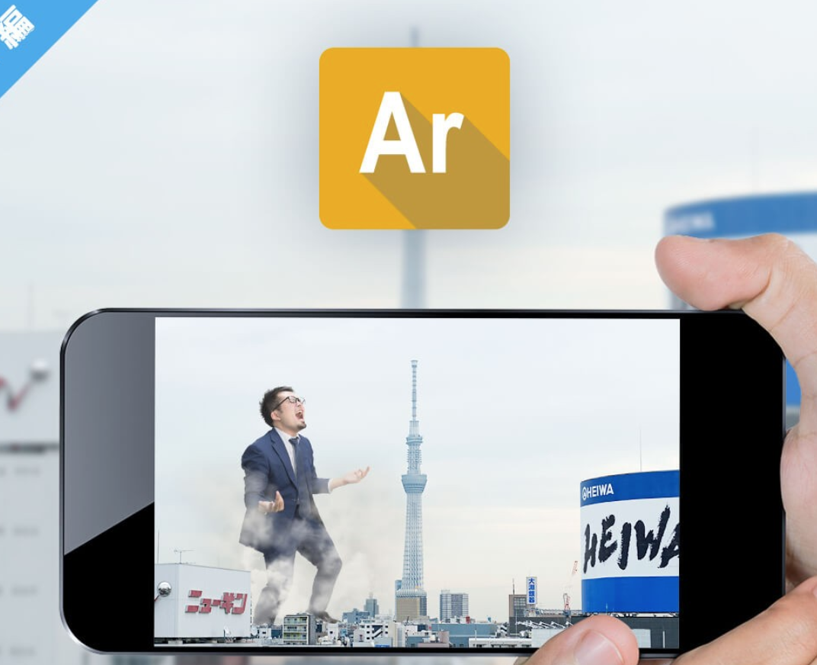
Goal
Creating immersive visualizations for mobile device using AR/MR web tools
What did they do?
Built a prototype using web technologies -> comes hand to hand with visualization
D3 A-frame Argon.js
*Images are not my own - links in description
Notes:
Some text is copied from the paper
*Images are not my own - links in description

Slide 6
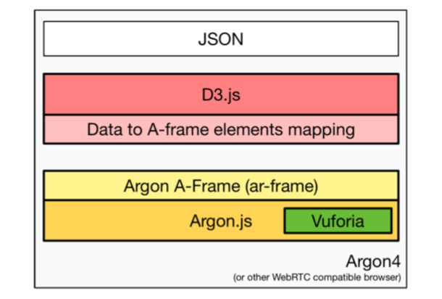
Prototype /methods
Argon -> allows for any 3d view to be augmented on a web framework
D3.js -> for manipulation of data translated from json / color information - mapping
Aframe <extention> ->data mapping / into AR
Notes:
Some text is copied from the paper
1) showed lack of work done in AR/MR sphere
built a web framework
using D3 library
argon allows for any 3d view to be augmented
used argon specific ar extension - Aframe( for content on webpage) / webVR - bascilt yhe ar toolkit includes what they need todo (geolocation or marker-based) Vuforia framework

Slide 7
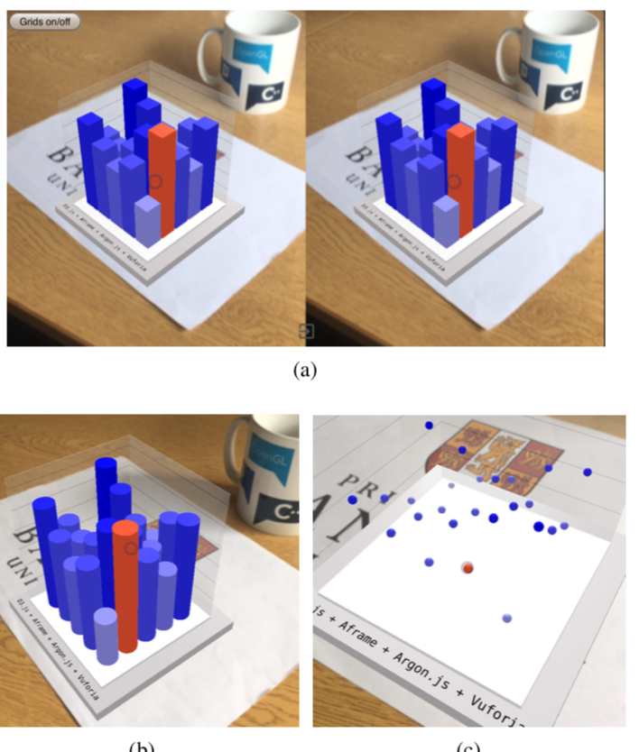
results?
All the tools used played nicely together
B) preliminary user testing showed:
Robust - fast and smooth rendering :)
Missing components needed ( like bar annotation and selection methods to be shown)
Work in progress
This was in 2017.
”” prototype application combines the versatility of D3.js, in terms of handling data, with the capabilities of the Argon framework, for doing handheld AR/MR. To our knowledge, this is the first demonstration of this combination, and albeit simple, it demonstrates the strength of the synergy, between these frameworks.””
“
Notes:
Some text is copied from the paper

Slide 8
results?
All the tools used played nicely together
B) preliminary user testing showed:
Robust - fast and smooth rendering :)
Missing components needed ( like bar annotation and selection methods to be shown)
Work in progress
This was in 2017!
“
our prototype application combines the versatility of D3.js, in terms of handling data, with the capabilities of the Argon framework, for doing handheld AR/MR. To our knowledge, this is the first demonstration of this combination, and albeit simple, it demonstrates the strength of the synergy, between these frameworks.”
“
Notes:
Some text is copied from the paper

Slide 9

Thoughts ?
Some of the statements they made felt either odd or if true, shocking.
Such as AR/MR research was not as popular( that most of it is based on VR?) - but retracted somewhat
Or others felt obvious, such as synergy between web frameworks, although I think this paper has an extension to it
IEEE vis poster paper
Notes:
is it convincing - yeah research is needed - generally new field but it has been here for a while now so i do not agree that it is as new as was implied. ( at least not to that extent ) the whole basis of the research was done because of 1) inherit challenges with the nature of MR/AR ( but isn't this the same for VR--- in favor of VR but not AR?) if they stated it as MR/AR issue oppsoed to vr ... 2) AR content creation tools were made as a side product of VR?
Some text is copied from the paper
m this paper alone it is not convincing, i feel like i need to read more - read other extension of work
can agree that ok there is synergy between components but also its all web based - so not sure what that has to do with anything or where they were going with this…
Cool read though :)

Slide 10


Authors: professors in Bangor University - bio from their prospective sites and google scholar
Panagiotis D. Ritsos
“human-computer interaction, and include mixed and virtual reality, information visualization, visual analytics and wearable computing.”
2002- 2018 alot of papers were in IA - (including other papers in these slides )
James R Jackson - professor of psychology
Google scholar mistake!
Student?
“research is interdisciplinary, investigating (1) how to visualize and analyze large datasets, (2) how to communicate and discuss the results with different experts(3) learning analytics and how to design, sketch and plan data visualization tools.
Notes:
Some text is copied from the paper

Slide 11
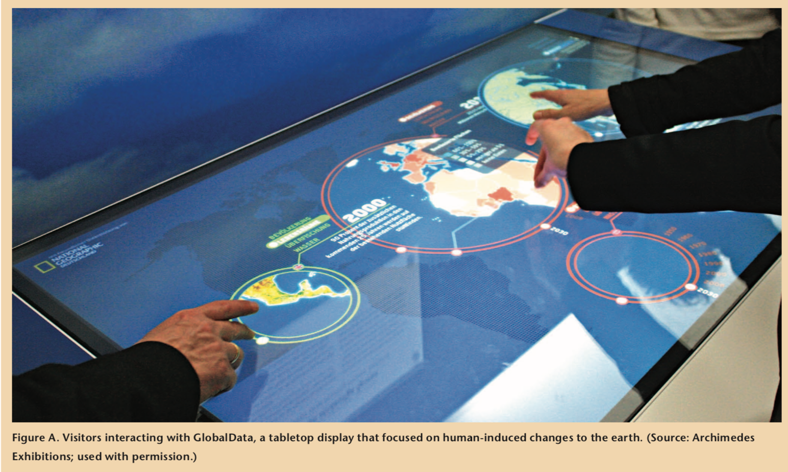
Data Visualization on Interactive Surfaces: A Research Agenda
What’s it about?
the article analyzes interactive tabletop surfaces ( ITS)
discusses the possibilities of the research space by introducing the challenges/problems faced with visual analytics in relation to ITS
Proposes future possibilities and prompts research questions
chandler's paper cites it to showcase the natural collaborations that arise from tabletop interfaces
Notes:
Some text is copied from the paper

Slide 12
"To learn how to best leverage the possibilities of ITSs for visualization, researchers must address three main types of challenges"
What's the problem?
Technical Challenges
Surface types .
Combining ITS( think classrooms / museums )
The Design Challenges
data representations for ITSs,
touch interaction as input
Coordinating input and data dimensions.
The Social Challenges
Collaboration
Evaluation
Notes:
(MDEs)
Related how to best showcase data best it can be
Some text is copied from the paper

Slide 13
"Touch interaction can be realized in many ways; however, not much research has investigated how people can best use it for visualizations"
Proposed solutions or new ideas of research!
Technical Challenges
Surface types> location - size .
A need to investigate surface types and settings
suited for what type of data
Combining ITS- Multi Display environments( think classrooms / museums )
Need to Research into how MDEs can be work in both single and multi-visualizations environments
Notes:
(MDEs)
Related how to best showcase data best it can be
Roough draft above - just getting points for now --- edit this

Slide 14
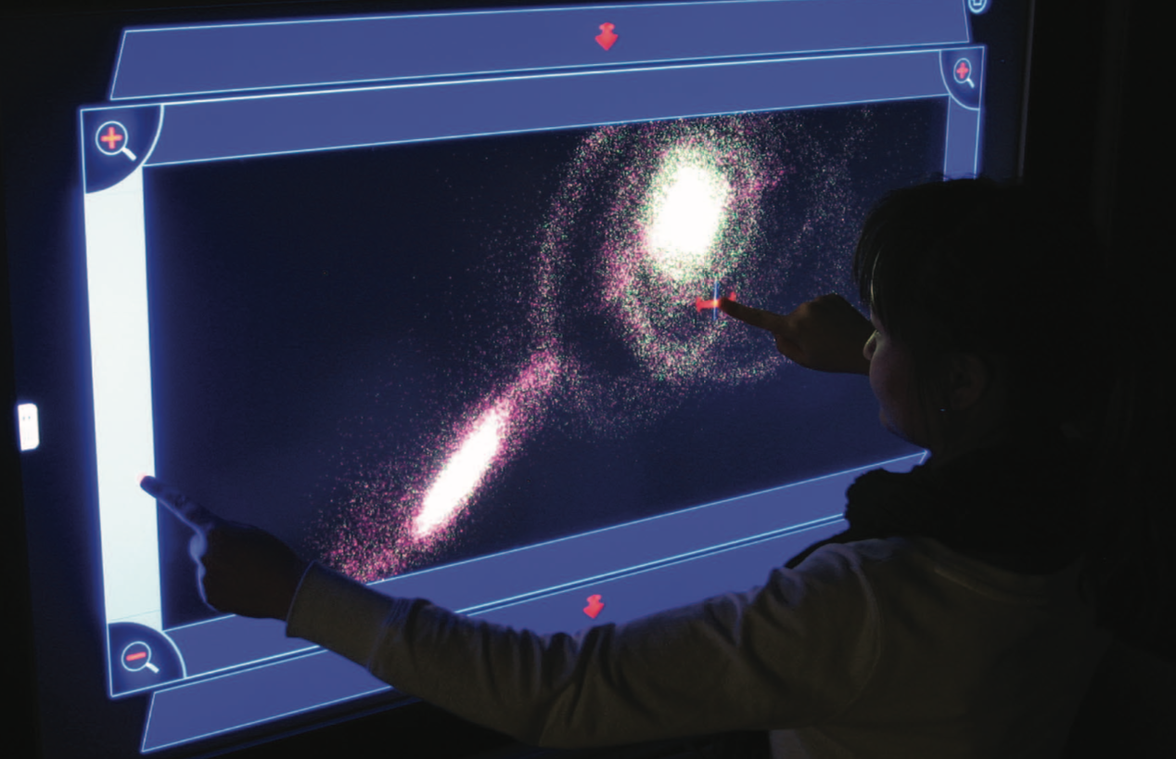
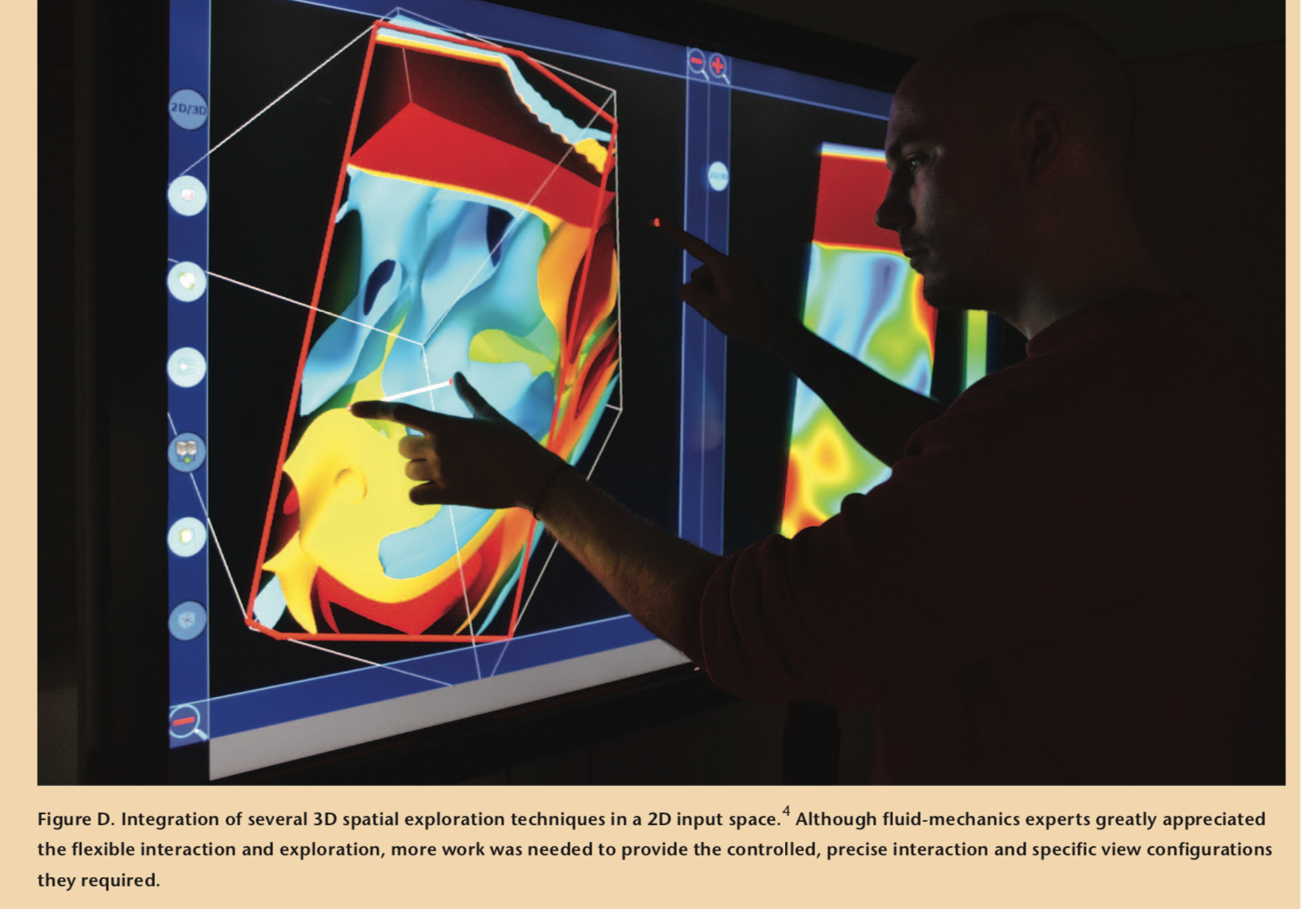
ons"
Proposed solutions /new ideas of research!
The Design Challenges
data representations for ITS - think viewing angle / screen size
Suggested creating surface-specific guidelines and vis tool kits
touch interaction as input
Suggested researching or creating a vocabulary for touch interactions -> eliminates need to learn specific interaction for each usecase
Coordinating input and data dimensions.
This may be a unique problem for ITS -> ex: translating a multidimensional data ( most common data used ) into a 2d surface
Notes:
(MDEs)
Related how to best showcase data best it can be
Roough draft above - just getting points for now --- edit this

Slide 15
ons"
Proposed solutions /new ideas of research!
The Design Challenges
data representations for ITS - think viewing angle / screen size
Suggested creating surface-specific guidelines and vis tool kits
touch interaction as input
Suggested researching or creating a vocabulary for touch interactions -> eliminates need to learn specific interaction for each usecase
Coordinating input and data dimensions.
This may be a unique problem for ITS -> ex: translating a multidimensional data ( most common data used ) into a 2d surface
Notes:
(MDEs)
Related how to best showcase data best it can be
Roough draft above - just getting points for now --- edit this

Slide 16
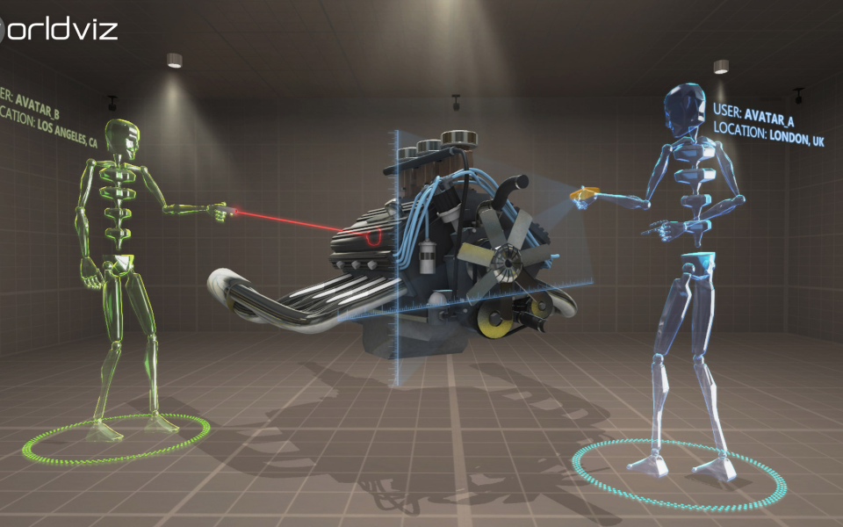
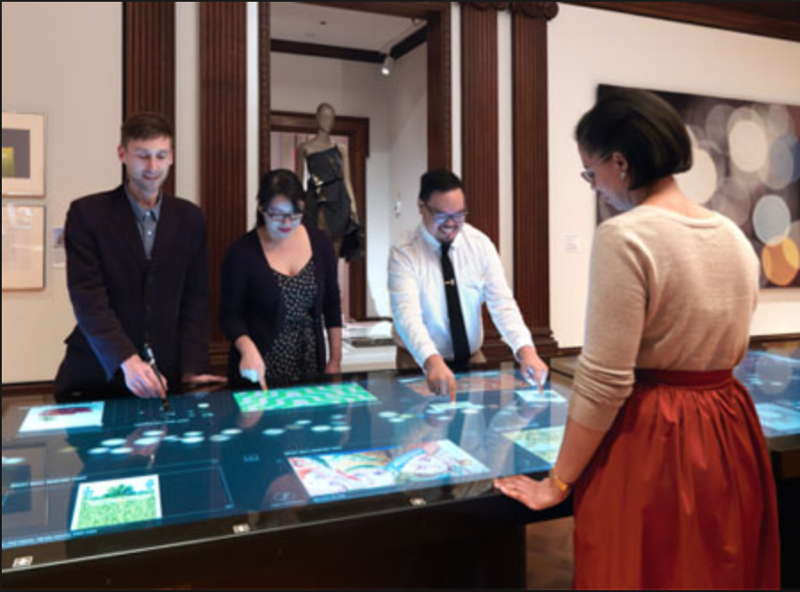

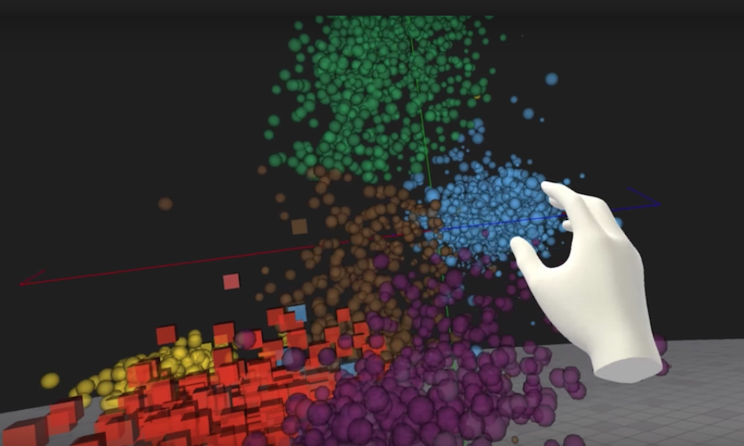
The Social Challenges
Collaboration
Suggested step by step instructions for users
Researching what data types work best for collaboration
Evaluation
Difficult to study
Need dedicated research
VS
Thoughts: some of the problems presented as unique to ITS is not really unique, I think it can be applied in MR/VR studies, especially the multidimensionality representation problems
Interesting translation possibilities into VR/AR/MR
Ex: combining multiple methods ( vr and ar? ) - control interactions
Presents interesting questions to explore:
Applicability to other forms of data representation
Notes:
Some text is copied from the paper

Slide 17
The Social Challenges
Collaboration
Suggested step by step instructions for users
Researching what data types work best for collaboration
Evaluation
Difficult to study
Need dedicated research
VS
Thoughts: some of the problems presented as unique to ITS is not really unique, I think it can be applied in MR/VR studies, especially the multidimensionality representation problems
Interesting translation possibilities into VR/AR/MR
Ex: combining multiple methods ( vr and ar? ) - control interactions
Presents interesting questions to explore:
Applicability to other forms of data representation
Notes:
Some text is copied from the paper

Slide 18
who and where
IEEE Computer Graphics and Applications - 2003 - visualization viewpoints
France---
Authors:
Petra Isenberg
“main research interests are: information visualization, visual analytics, computer-supported cooperative work, and human-computer interaction “
Tobias Isenberg
“My research focuses on interactive scientific visualization and illustrative rendering, using methods from computer graphics, non-photorealistic rendering (NPR), and human-computer interaction. I am specifically interested in (2D and, in particular, 3D) interaction techniques for work with illustrative visualizations on large, touch-sensitive displays as well as illustrative visualization that is inspired by traditional illustration.”\
Tobias Hesselmann
Data vis - HCI from papers published, no website on bio except for publication s
Notes:
Some text is copied from the paper

